Slide 1
Spark RDD - Operations
Pravin Y Pawar

Slide 2
RDD Operations
Two types of operations
Transformations
create a new dataset from an existing one
Actions
return a value to the driver program after running a computation on the dataset
For example,
map is a transformation that passes each dataset element through a function and returns a new RDD representing the results
reduce is an action that aggregates all the elements of the RDD using some function and returns the final result to the driver program

Slide 3
RDD Operations
Lazy evaluation and Persistence
Lazy evaluation
All transformations are lazy - not compute their results right away
Instead, they just remember the transformations applied to some base dataset (e.g. a file)
The transformations are only computed when an action requires a result to be returned to the driver program
This design enables Spark to run more efficiently.
Persistence
By default, each transformed RDD may be recomputed each time you run an action on it.
However, may also persist an RDD in memory using the persist (or cache) method
Spark will keep the elements around on the cluster for much faster access the next time you query it
There is also support for persisting RDDs on disk, or replicated across multiple nodes

Slide 4
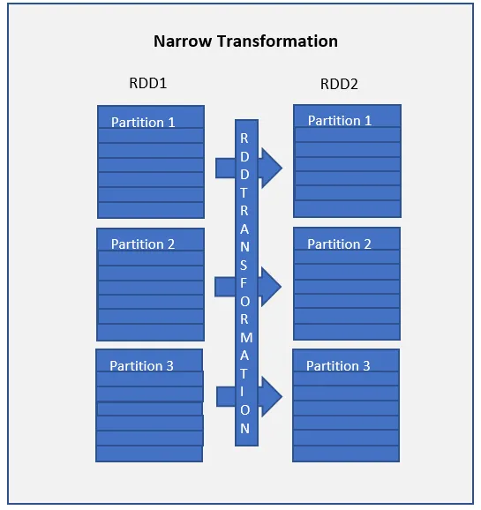
RDD Transformation Types
Two types : Narrow transformations
Narrow transformations
are the result of map() and filter() functions
compute data that live on a single partition meaning there will not be any data movement between partitions to execute narrow transformations
Functions such as
map()
mapPartition()
flatMap()
filter()
union()

Slide 5
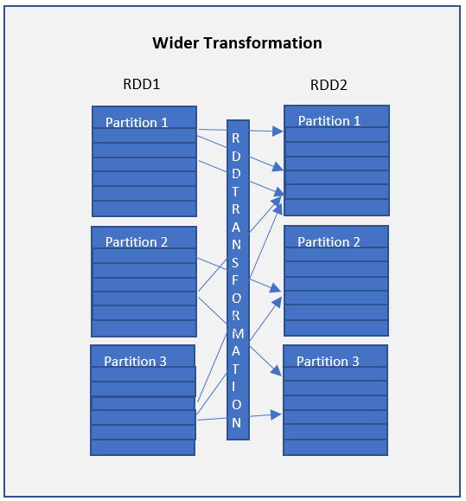
RDD Transformation Types (2)
Two types : Wider transformations
Wider transformations
are the result of groupByKey() and reduceByKey() functions
compute data that live on many partitions meaning there will be data movements between partitions to execute wider transformations
Shuffles the data, they also called shuffle transformations
Functions such as
groupByKey()
aggregateByKey()
aggregate()
join()
repartition()

Slide 6
RDD Action
Actions are Spark RDD operations that give non-RDD values
Transformations create RDDs from each other, but when want to work with the actual dataset, at that point action is performed
When the action is triggered after the result, new RDD is not formed like transformation
Values of action are stored to drivers or to the external storage system
It brings laziness of RDD into motion
An action is one of the ways of sending data from Executer to the driver
Executors are agents that are responsible for executing a task
Driver is a JVM process that coordinates workers and execution of the task
Examples
count()
collect()
take()
top()

Slide 7
RDD Transformation : Example
map(func)
The map function iterates over every line in RDD and split into new RDD
Using map() transformation, function is applied to every element of RDD
In the map, the input and the return type of RDD may differ from each other
For example
Let RDD has elements {1, 2, 3, 4, 5}
Apply “rdd.map(x => x + 5 )”
Result as (6, 7, 8, 9, 10)

Slide 8
RDD Transformation : Example (2)
flatMap()
When the flatMap() function is applied on RDD, to each input element, results into many elements in an output RDD
The most simple use of flatMap() is to split each input string into words
Map and flatMap are similar in the way that they take a line from input RDD and apply a function on that line
The key difference between map() and flatMap() is map() returns only one element, while flatMap() can return a list of elements
Example,
val data sc.textFile("spark_test.txt")
val flatmapFile = data.flatMap(lines => lines.split(" "))

Slide 9
RDD Transformation : Example (3)
filter(func)
Returns a new RDD, containing only the elements that meet a predicate
A narrow operation because it does not shuffle data from one partition to many partitions
For example
RDD contains first five natural numbers (1, 2, 3, 4, and 5)
Predicate is check for an even number
The resulting RDD after the filter will contain only the even numbers i.e., 2 and 4
Another example
val data = sc.textFile("spark_test.txt")
val mapFile = data.flatMap(lines => lines.split(" ")).filter(value => value=="spark")

Slide 10
RDD Transformation : Example (4)
union(dataset)
Get the elements of both the RDD in new RDD
The key rule of this function is that the two RDDs should be of the same type
For example
Elements of RDD1 are (Spark, Spark, Hadoop, Flink)
Elements RDD2 are (Big data, Spark, Flink)
Apply rdd1.union(rdd2)
Result elements (Spark, Spark, Spark, Hadoop, Flink, Flink, Big data)

Slide 11
RDD Transformation : Example (5)
intersection(dataset)
Get only the common element of both the RDD in new RDD
The key rule of this function is that the two RDDs should be of the same type
For example,
Elements of RDD1 are (Spark, Spark, Hadoop, Flink)
Elements of RDD2 are (Big data, Spark, Flink)
Apply rdd1.intersection(rdd2)
Resultant RDD will have elements (spark)

Slide 12
RDD Transformation : Example (6)
distinct()
Returns a new dataset that contains the distinct elements of the source dataset
Helpful to remove duplicate data
For example,
RDD has elements (Spark, Spark, Hadoop, Flink)
Apply rdd.distinct()
Resultant RDD give elements (Spark, Hadoop, Flink)

Slide 13
RDD Action : Example
count()
Action count() returns the number of elements in RDD
For example,
RDD has values {1, 2, 2, 3, 4, 5, 5, 6}
Apply “rdd.count()”
Result will be 8

Slide 14
RDD Action : Example (2)
collect()
Common and simplest operation that returns entire RDDs content to driver program
entire RDD is expected to fit in memory
makes easy to compare the result of RDD with the expected result
Action Collect() had a constraint that all the data should fit in the machine, and copies to the driver

Slide 15
RDD Action : Example (3)
take(n)
Returns “n” number of elements from RDD
Tries to cut the number of partition it accesses, so it represents a biased collection
cannot presume the order of the elements.
For example,
Consider RDD {1, 2, 2, 3, 4, 5, 5, 6}
Apply “take (4)”
Result will be { 2, 2, 3, 4}

Slide 16
RDD Action : Example (4)
countByValue()
Returns, how many times each element occur in RDD
For example,
RDD has values {1, 2, 2, 3, 4, 5, 5, 6}
Apply “rdd.countByValue()”
Result will be {(1,1), (2,2), (3,1), (4,1), (5,2), (6,1)}

Slide 17
RDD Action : Example (5)
reduce()
Takes the two elements as input from the RDD and then produces the output of the same type as that of the input elements
The simple forms of such function are an addition
For example,
numbers = sc.parallelize([1,7,8,9,5,77,48])
# aggregate RDD elements using addition function
sum = numbers.reduce(lambda a,b:a+b)
print "sum is : " + str(sum)

Slide 18
RDD Action : Example (6)
foreach()
foreach() function is useful
When we have a situation where we want to apply operation on each element of RDD, but it should not return value to the driver
. For example,
inserting a record into the database
val data = sc.parallelize(Array(('k',5),('s',3),('s',4),('p',7),('p',5),('t',8),('k',6)),3)
val group = data.groupByKey().collect()
group.foreach(println)

Slide 19
RDD Action : Example (7)
saveAs…()
saveAsTextFile(path)
Write the elements of the dataset as a text file (or set of text files) in a given directory in the local filesystem, HDFS or any other Hadoop-supported file system
Spark will call toString on each element to convert it to a line of text in the file
saveAsSequenceFile(path)
Available in Java and Scala
Write the elements of the dataset as a Hadoop SequenceFile in a given path in the local filesystem, HDFS or any other Hadoop-supported file system
saveAsObjectFile(path)
Available in Java and Scala
Write the elements of the dataset in a simple format using Java serialization, which can then be loaded using SparkContext.objectFile()

Slide 20
Thank You!
Reference :
Learning Spark By Karau, Konwinski
Spark Documentation
In our next session: Spark Paired RDDs

